Slide 1
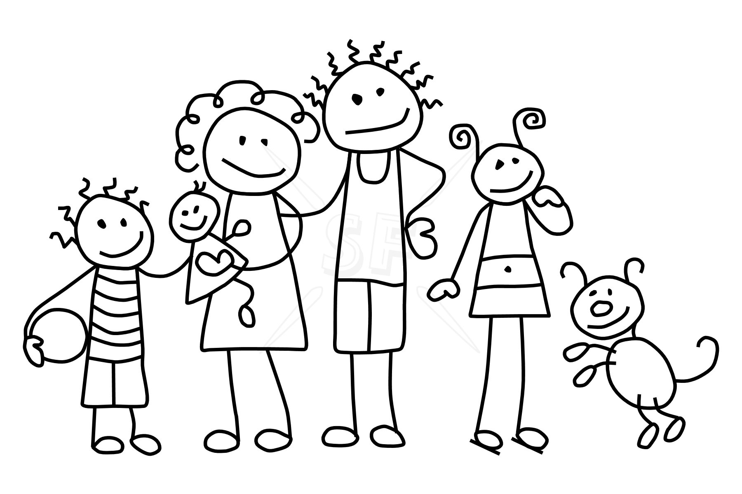
I believe that family is the most important ingredient when baking.

Slide 2
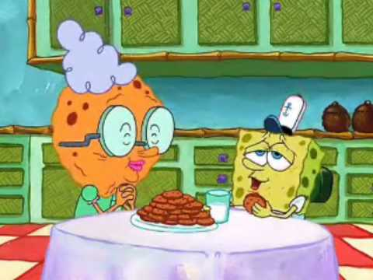
Have you ever wondered why Grandma’s cookies taste so good? When you ask her the recipe; it seems simple, but when you make them, they never come out just the way hers do. It’s because she can’t write love on a list of ingredients, but it is the most important one.

Slide 3
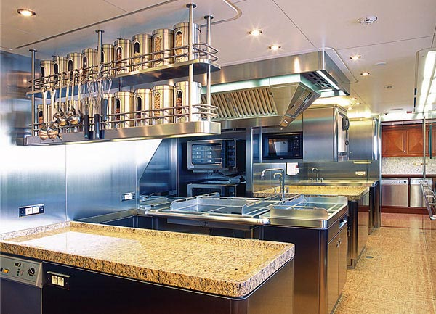
I know because my family owns a five star cake bakery: our warm little kitchen. My mom and dad have all the best tools: their cheap blenders, pastry spatula, and their love of creativity. And they have the best crew in the country: their family, who doesn’t even help.

Slide 4
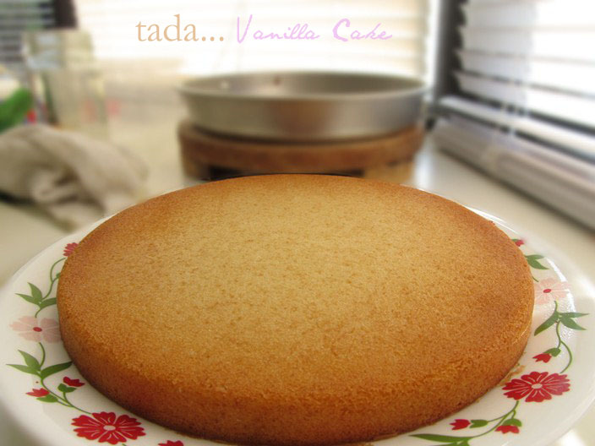
One morning I woke up to the warm, comforting smell of the vanilla cakes baking in the oven. Here we go again, the thought crossed my mind.
I walked downstairs to our kitchen, only to be greeted by my mom’s fierce mixing and my dad’s precise cutting. I came down the rest of the stairs and sat in the chair across from the messy island they were at work on. They didn’t like anything to be on the island while they were working; as if anything could fit.

Slide 5
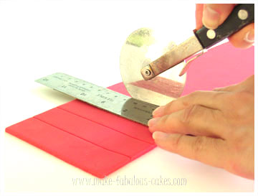
My mom’s powdered sugar sprinkled the table-top, mixing with the strips of fondant that my dad had cut away from a creation that he’d been constructing.
I didn’t always talk, but mostly watched as they worked. Though they didn’t say much to each other as they worked on their separate sections, I knew they were in sync; always thinking the same thing. My dad would finish cutting a piece and ask my mom how it was. She’d always give him a satisfactory smile as if it was her own idea of the creation, like she would have cut it the exact same way.
The smell of the icing filled my nose as I told my mom that I want to punch the teddy bear that she’d baked. It was fun to tease her and get my dad to quietly chuckle when he momentarily lost focus. My brother and I worked simultaneously at teasing my mom whenever she and my dad baked.
Even their minor baking difficulties couldn’t penetrate the blissful mood.

Slide 6
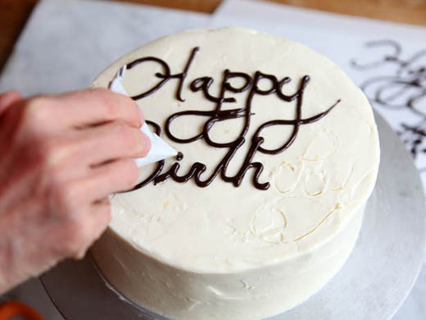
My mom picked up the candy writing tool and began writing on the chocolate books she made. They were small and I told her that she probably shouldn’t try to write on them, but she decided that she was going to do it; and that was that.
I watched her move the tool in different directions, attempting to make words in cursive. For a little while, I thought they were going to turn out well, and I’d have to eat my words. But when I got up from my seat and went over to take a look, I busted out in laughter as I looked at the mush of words that she’d tried to create.
“The words are too long, it doesn’t even fit,” I said though my fit of amusement.
Even though she didn’t think it was funny, she chuckled at my fit anyway and smiled as she said, “I’m finishing them!”

Slide 7
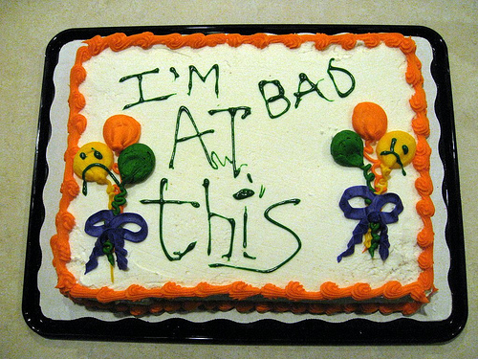
We snickered together as she told my dad that I was crazy. My dad laughed at us, and checked them out for himself. His eyes widened slightly and he smiled as well. I could tell that he knew I’d made a good point, but he told her they looked fine anyway. While she finished them, I just kept giggling. Sometimes she would smile, and ask me what I’m laughing at. Of course, she knew.

Slide 8
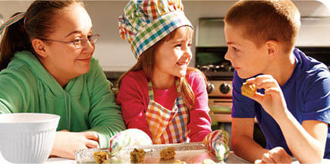
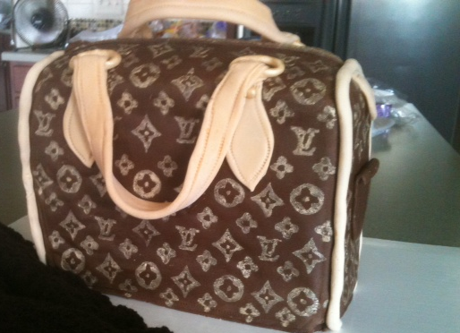
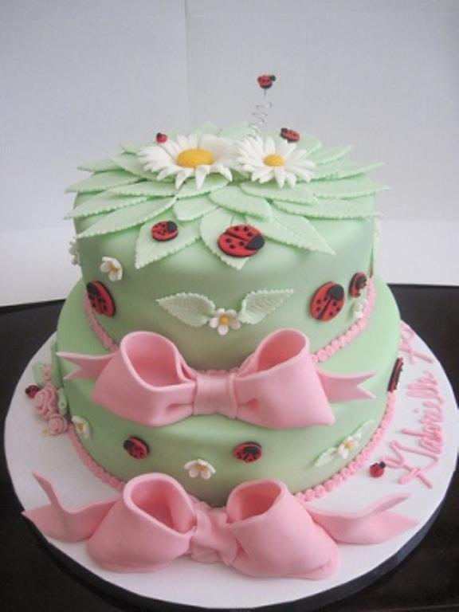
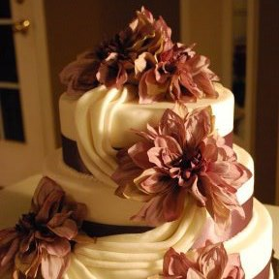
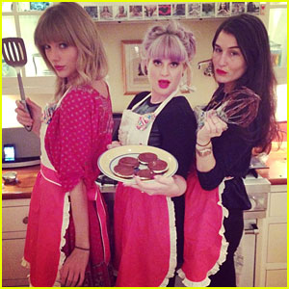
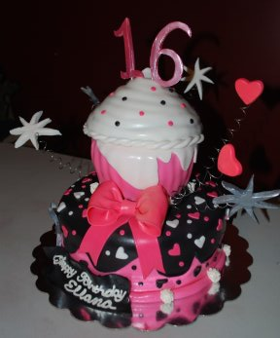
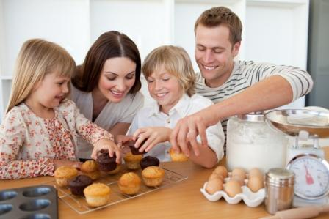
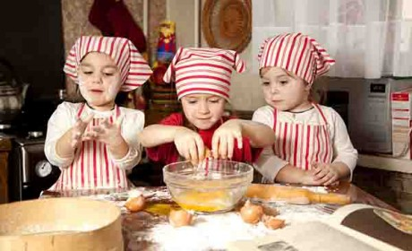
I loved watching them bake, because that’s what they enjoyed. It made me enjoy baking too, but I enjoy the other side of baking. I don’t like the mixing and putting the cakes in the oven; I like the glow on my mom’s face as she mixes and places it into the oven. I don’t like the cutting and the measuring; I like to see my dad concentrating on the artistic talent that he rarely puts to good use. I don’t like making fun of my mom’s cakes with my brother; I like the laughter it brings and the warm smiles they give us as we joke with them. We all liked to look at the extravagant Louis Vuitton purse cakes, the football helmets, and the Philly Phanatic; and to never dream of cutting into them. We can all tell that we enjoy each other, and that’s the most important ingredient, isn’t it?

